Slide 1
Exercising Faith (Pt. 3)
Through Faith Based on Relationship

Slide 2
The Love Relationship
Jesus Christ has revealed as no one else has done, the heart of the Eternal, so that we know God not only as the infinite Creator, the Absolute Reason, the Omnipotent King, but as the All-loving Father, whose sovereignty is a sovereignty of love, whose law is as merciful as it is just, and whose abounding grace is a regenerating force which can quicken even those who are dead in trespasses and sins. (President L. Clark Seelye Of Smith College, Union University Quarterly, Volume 2, p. 128, 1905)

Slide 3
2 Cor. 4:3-4
If our Message is obscure to anyone, it's not because we're holding back in any way. No, it's because these other people are looking or going the wrong way and refuse to give it serious attention. All they have eyes for is the fashionable god of darkness. They think he can give them what they want, and that they won't have to bother believing a Truth they can't see. They're stone-blind to the dayspring brightness of the Message that shines with Christ, who gives us the best picture of God we'll ever get. (2 Cor. 4:3-4; The Message Bible)
The god who rules this world has blinded the minds of unbelievers. They cannot see the light, which is the good news about our glorious Christ, who shows what God is like (2 Cor. 4:4; Contemporary English Version)

Slide 4
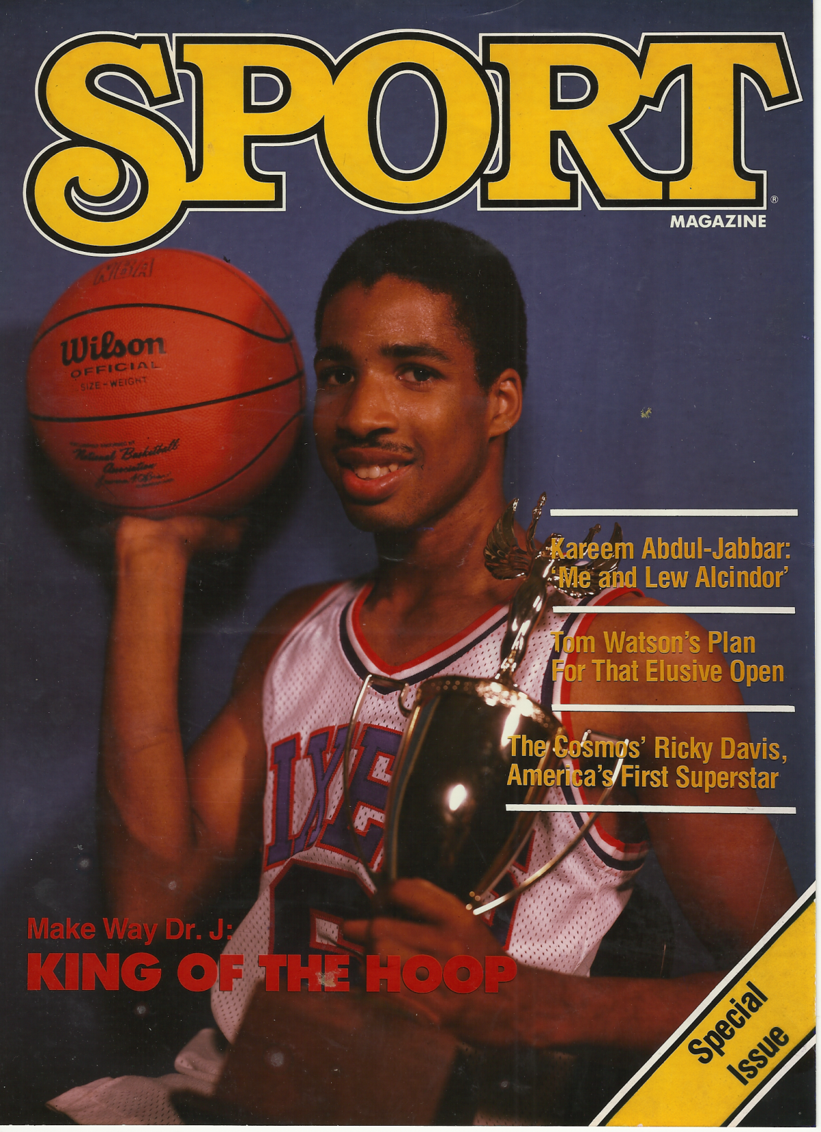

Slide 5
The Love Relationship
What is this picture of God that Christ gives us?
Is it not that of a loving kind Heavenly Father who delights in answering our prayers and giving us the things that we need and desire (Godly desires)?

Slide 6
John 16:23-27
John 16:23 And in that day ye shall ask me nothing. Verily, verily, I say unto you, Whatsoever ye shall ask the Father in my name, he will give it you.
John 16:24 Hitherto have ye asked nothing in my name: ask, and ye shall receive, that your joy may be full.
John 16:25 These things have I spoken unto you in proverbs: but the time cometh, when I shall no more speak unto you in proverbs, but I shall shew you plainly of the Father.
John 16:26 At that day ye shall ask in my name: and I say not unto you, that I will pray the Father for you:
John 16:27 For the Father himself loveth you, because ye have loved me, and have believed that I came out from God.

Slide 7
Matt. 6:7-9 (The Message)
Matt. 6:7 "The world is full of so-called prayer warriors who are prayer-ignorant. They're full of formulas and programs and advice, peddling techniques for getting what you want from God.
Matt. 6:8 Don't fall for that nonsense. This is your Father you are dealing with, and he knows better than you what you need.
Matt. 6:9 With a God like this loving you, you can pray very simply. Like this: Our Father in heaven, Reveal who you are.

Slide 8
The Love Relationship
Our picture of God can sometimes be distorted by tyrannical human kings or abusive earthly fathers.
Sometimes our picture of God can be the neglectful father who always makes and breaks promises.
Sometimes it is the distant father who is never in our lives.
We must rid ourselves of distorted stereotypes about God based on human comparisons. Instead get a picture of what a father is really supposed to be like by looking at God instead of the other way around.
Do not measure God by humans. Measure humans by God.

Slide 9
Isa. 55
Isaiah 49:13 Sing, O heavens; and be joyful, O earth; and break forth into singing, O mountains: for the LORD hath comforted his people, and will have mercy upon his afflicted.
Isaiah 49:14 But Zion said, The LORD hath forsaken me, and my Lord hath forgotten me. [Distorted picture of God]
Isaiah 49:15 Can a woman forget her sucking child, that she should not have compassion on the son of her womb? yea, they may forget, yet will I not forget thee.
Isaiah 49:16 Behold, I have graven thee upon the palms of my hands; thy walls are continually before me.

Slide 10
The Love Relationship
Often when we do not see our prayers answered immediately we believe that God has forgotten us.
Distorted views of God are the major contributors to a lack of trust in Him.
With the right picture of God we will persevere in prayer until we see the answers to prayer.
God is the prime example of what a parent should be like. Parents often fall short of the true ideal (God) and God should not be compared to our human parental failures which are often born our of selfish motives.

Slide 11
Matt. 7:7-11
Matt. 7:7 Ask, and it shall be given you; seek, and ye shall find; knock, and it shall be opened unto you:
Matt. 7:8 For every one that asketh receiveth; and he that seeketh findeth; and to him that knocketh it shall be opened.
Matt. 7:9 Or what man is there of you, whom if his son ask bread, will he give him a stone?
Matt. 7:10 Or if he ask a fish, will he give him a serpent?
Matt. 7:11 If ye then, being evil, know how to give good gifts unto your children, how much more shall your Father which is in heaven give good things to them that ask him?
As bad as you are, you wouldn't think of such a thing. You're at least decent to your own children. So don't you think the God who conceived you in love will be even better? (Matt. 7:11; The Message Bible)

Slide 12
Knowing that God loves Us
If the most decent father will do good things for us then God, who is unselfish, other-focused love, will do even greater things for His children.

Slide 13
James 1:16-17
James 1:16 Do not err, my beloved brethren.
James 1:17 Every good gift and every perfect gift is from above, and cometh down from the Father of lights, with whom is no variableness, neither shadow of turning.
James 1:16 So, my very dear friends, don't get thrown off course.
James 1:17 Every desirable and beneficial gift comes out of heaven. The gifts are rivers of light cascading down from the Father of Light. There is nothing deceitful in God, nothing two-faced, nothing fickle.
James 1:18 He brought us to life using the true Word, showing us off as the crown of all his creatures. (The Message Bible)

Slide 14
Look at God’s Character: God is Completely TRUSTWORTHY

Slide 15
Psalm 91
1 He that dwelleth in the secret place of the most High shall abide under the shadow of the Almighty. 2 I will say of the LORD, He is my refuge and my fortress: my God; in him will I trust.
3 Surely he shall deliver thee from the snare of the fowler, and from the noisome pestilence. 4 He shall cover thee with his feathers, and under his wings shalt thou trust: his truth shall be thy shield and buckler.
5 Thou shalt not be afraid for the terror by night; nor for the arrow that flieth by day; 6 Nor for the pestilence that walketh in darkness; nor for the destruction that wasteth at noonday.

Slide 16
What does it mean to be “trustworthy”
The Bible often uses the word “faithfulness” which basically means “trustworthy”.
Pistis - fidelity, faithfulness; the character of one who can be relied on
The first key to exercising faith is to know the truth about God’s character – that He is completely worthy of our trust.

Slide 17
God is Completely “Trustworthy”
1Co 1:9 God is faithful (reliable, trustworthy, and therefore ever true to His promise, and He can be depended on); by Him you were called into companionship and participation with His Son, Jesus Christ our Lord. (Amplified)

Slide 18
Trust Based on Relationship
The word “companionship” (KJV uses the word “fellowship”) is from the Greek word koinonia which is in relation to “community” or “intimacy”.
One cannot count God as worthy of their trust apart from a true relationship with Him.

Slide 19
God is Completely “Trustworthy”
Heb 11:11 Because of faith also Sarah herself received physical power to conceive a child, even when she was long past the age for it, because she considered [God] Who had given her the promise to be reliable and trustworthy and true to His word.(5) (Amplified)

Slide 20
Why this Emphasis on God being Worthy of Trust?
God has been lied on time and time again concerning His character.
These lies have not only come from Satan, but Satan has actually been able to propagate lies concerning God’s character through the church.

Slide 21
God’s Character Slandered
1 Now the serpent was more subtil than any beast of the field which the LORD God had made. And he said unto the woman, Yea, hath God said, Ye shall not eat of every tree of the garden? 2 And the woman said unto the serpent, We may eat of the fruit of the trees of the garden: 3 But of the fruit of the tree which is in the midst of the garden, God hath said, Ye shall not eat of it, neither shall ye touch it, lest ye die.
4 And the serpent said unto the woman, Ye shall not surely die: 5 For God doth know that in the day ye eat thereof, then your eyes shall be opened, and ye shall be as gods, knowing good and evil.
6 And when the woman saw that the tree was good for food, and that it was pleasant to the eyes, and a tree to be desired to make one wise, she took of the fruit thereof, and did eat, and gave also unto her husband with her; and he did eat

Slide 22
The first sin was a “Breach of Trust”
Satan painted a picture of God as egotistical, selfish, tyrannical, and totally untrustworthy.
He does the same thing today, often using religious terminology:
God’s ways are mysterious. You never know what He will do.
God is sovereign so what is happening in your life is His will for you.
God did not answer your prayer because it was not His will, in spite of what the Bible promised you.
God is angry with you and will destroy you you wretched sinner.
God does not love you

Slide 23
Lack of trust resulted in “death” which is separation
Failure to believe what God says about Himself rather than what His enemy said brought death upon Adam and Eve.
This “death” did not start as “physical”. It was seperation from the life of God.
Separation from God means a break in the relationship with Him.
Unlike Adam and Eve, we must be more like Sarah, who judged God as “trustworthy”.

Slide 24
God is Completely “Trustworthy”
Although not all believe God's words, this does not affect His faithfulness towards those He had chosen. It is unthinkable that He would ever be unfaithful; He is true and trustworthy in every way, even though no man can make such a claim about himself. (Rom. 3:3-4; The Truth New Testament by Apostle Colin Urquhart)

