Slide 1
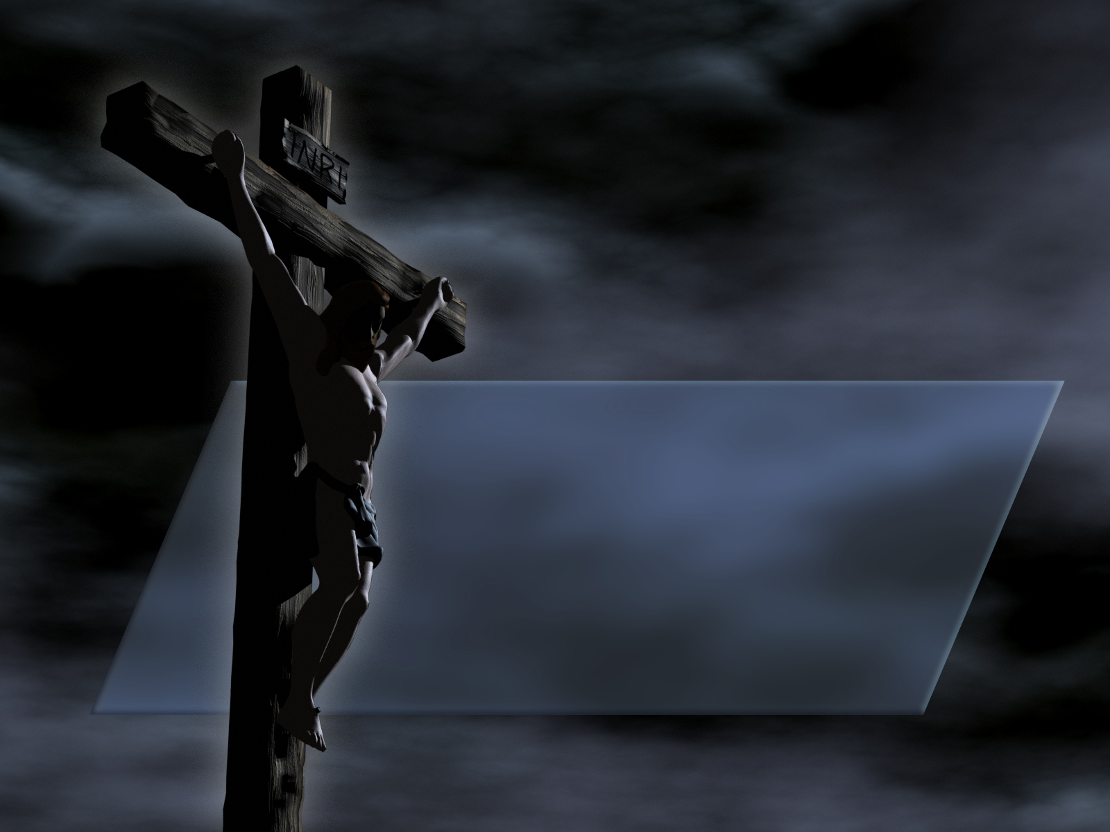
RISEN
Jesus’ Warfare and Victory Over Death and Satan

Slide 2
Death is the Natural Consequences of Sin
For the wages of sin is death; but the gift of God is eternal life through Jesus Christ our Lord. (Rom. 6:23)

Slide 3
Death is the Natural Consequences of Sin
But every man is tempted, when he is drawn away of his own lust, and enticed. Then when lust hath conceived, it bringeth forth sin: and sin, when it is finished, bringeth forth death. (James 1:14-15)

Slide 4
Death is the Natural Consequences of Sin
And the LORD God commanded the man, saying, Of every tree of the garden thou mayest freely eat: But of the tree of the knowledge of good and evil, thou shalt not eat of it: for in the day that thou eatest thereof thou shalt surely die. (Gen. 2:16-17)

Slide 5
Death is the Natural Consequences of Sin
And not only so, but we also joy in God through our Lord Jesus Christ, by whom we have now received the atonement. Wherefore, as by one man sin entered into the world, and death by sin; and so death passed upon all men, for that all have sinned (Rom. 5:11-12)

Slide 6
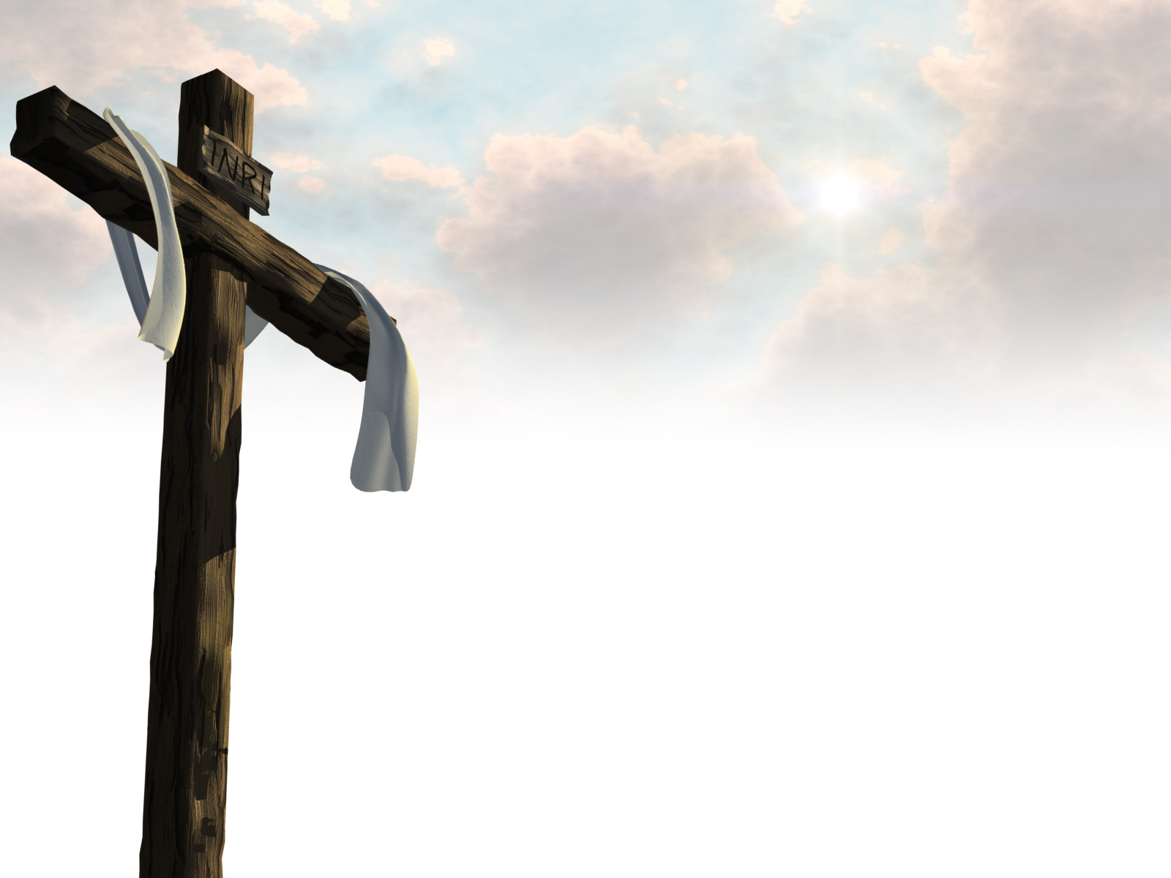
Think
Was this “death by God” or “death by sin”?

Slide 7
Is God Responsible for Death?
The Apocryphal book, “Wisdom of Solomon” tells us what the ancient Jews thought on this subject:

Slide 8
Is God Responsible for Death?
Seek not death in the error of your life: and pull not upon yourselves destruction with the works of your hands. For God made not death: neither hath he pleasure in the destruction of the living. For he created all things, that they might have their being: and the generations of the world were healthful; and there is no poison of destruction in them, nor the kingdom of death upon the earth: (Wisdom 1:12-14)

Slide 9
Is God Responsible for Death?
The canon confirms this truth:
I call heaven and earth to record this day against you, that I have set before you life and death, blessing and cursing: therefore choose life, that both thou and thy seed may live: (Deut. 30:19)

Slide 10
Is God Responsible for Death?
Say unto them, As I live, saith the Lord GOD, I have no pleasure in the death of the wicked; but that the wicked turn from his way and live: turn ye, turn ye from your evil ways; for why will ye die, O house of Israel? (Ezek. 33:11)

Slide 11
Death is God’s Enemy
For he must reign, till he hath put all enemies under his feet. The last enemy that shall be destroyed is death. (1 Cor. 15:25-26)

Slide 12
The Truth about Death
Death is an enemy of God
God is LIFE. Anything that goes contrary to Him leds to DEATH.

Slide 13
Satan is the Wielder of Death
Forasmuch then as the children are partakers of flesh and blood, he also himself likewise took part of the same; that through death he might destroy him that had the power of death, that is, the devil; And deliver them who through fear of death were all their lifetime subject to bondage. (Heb. 2:14-15)

Slide 14
Jesus Conquered Death for Us
But now is Christ risen from the dead, and become the firstfruits of them that slept. For since by man came death, by man came also the resurrection of the dead. For as in Adam all die, even so in Christ shall all be made alive. (1 Cor. 15:20-24)

Slide 15
Jesus Conquered Death for Us
So when this corruptible shall have put on incorruption, and this mortal shall have put on immortality, then shall be brought to pass the saying that is written, Death is swallowed up in victory. O death, where is thy sting? O grave, where is thy victory?

Slide 16
Jesus Conquered Death for Us
The sting of death is sin; and the strength of sin is the law. But thanks be to God, which giveth us the victory through our Lord Jesus Christ. (1 Cor. 15:54-56)

Slide 17
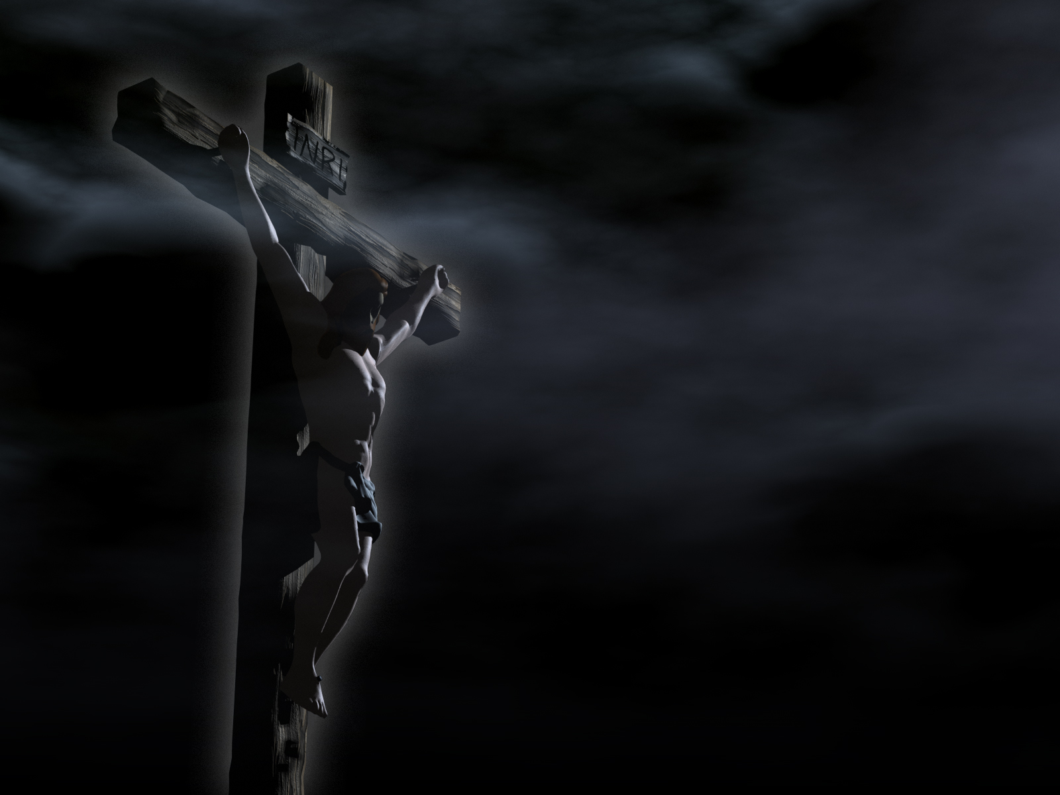
Jesus Did it ALL for YOU

